Slide 1
Search Engine for Recipe Dataset
Team Members: Janet Dick, Jonilyn Dick, and Navodita Mathur

Slide 2

Goals and Importance
The goal for this project was to design a search engine for a large variety of recipes. Incorporated with the search engine is a user-friendly interface that allows users to execute their query and have recipes returned that can then be accessed.
The end users envisioned for this project are the aspiring home chefs looking for their next challenge in the kitchen, busy parents looking for fresh and quick meals to put on the table, and people that have made the switch from going out to staying in due to social climate.
A recipe search engine is useful to a large and varied group of people, especially considering that the number of recipes that can exist is almost unlimited for as long as people have the access to explore new recipes and perhaps some inspiration. Without a search engine, looking for new recipes would be a time-consuming task that could possibly deter people from trying to cook at home!

Slide 3
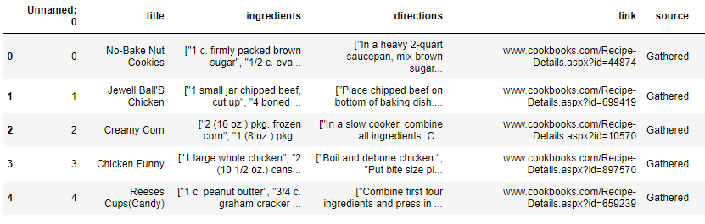
Details of Approach – Initial Input
The initial input for the search engine was sourced from Kaggle, it is a dataset containing over 2 million recipes gathered from multiple different sites across the web
Figure 1 is the first 5 rows of the dataset used
Figure 1: Dataset from Kaggle to be used for creating search engine - RecipeNLG (cooking recipes dataset) | Kaggle

Slide 4
Details of Approach – Processing Input
IngredientCollection
Takes the recipe dataset as input in form of pandas dataframe
Returns the title, ingredients, directions, and url of each recipe as string
WordTokenizer
Takes output from IngredientCollection as input
Removes punctuation and returns a word array
WordNormalizer
Takes output from WordTokenizer as input
Converts all cases to lowercase in word array, performs stemming, and returns each word
StopWordRemover
Takes output from WordTokenizer as input
Returns Boolean True/False if word is a stop word

Slide 5
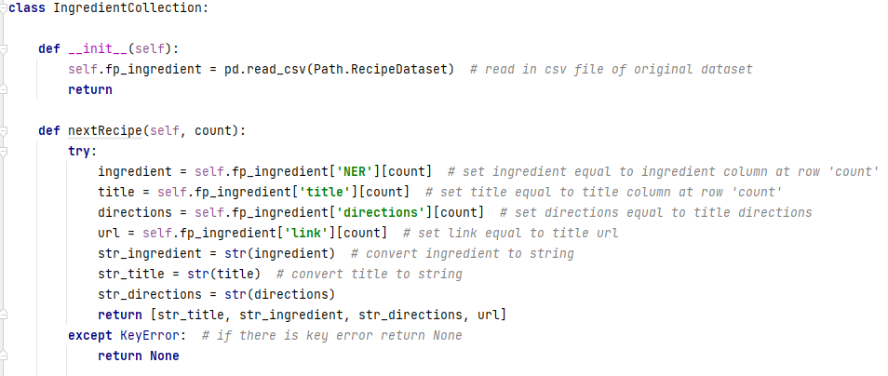
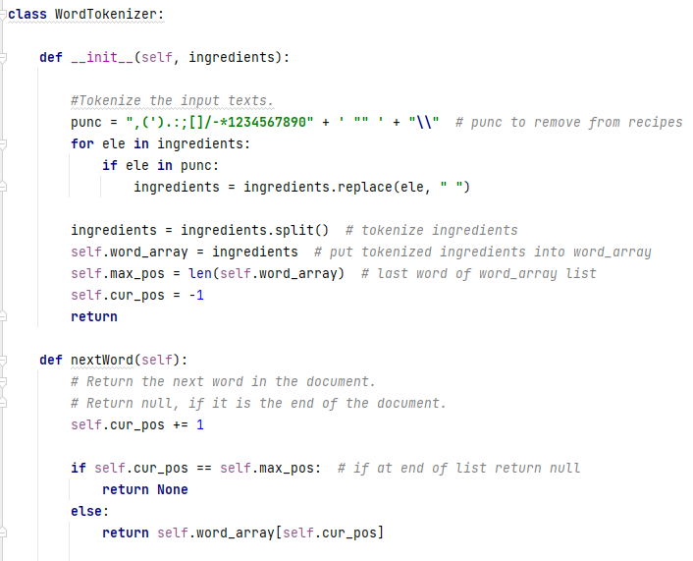
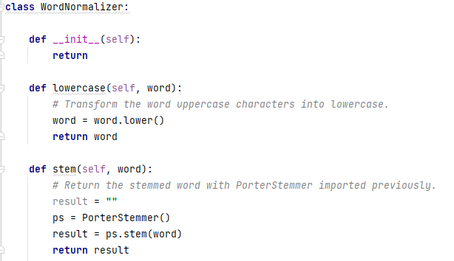
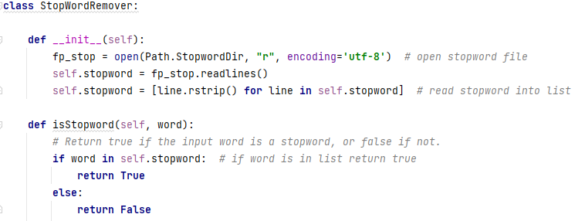
Details of Approach – Processing Input

Slide 6
Details of Approach – Processed Input
No-Bake Nut Cookies
bake nut cooki brown sugar milk vanilla nut butter bite size shred rice biscuit heavi quart saucepan mix brown sugar nut evapor milk butter margarin stir medium heat mixtur bubbl top boil stir minut heat stir vanilla cereal mix teaspoon drop shape cluster wax paper stand firm minut
www.cookbooks.com/Recipe-Details.aspx?id=44874
Jewell Ball'S Chicken
jewel ball chicken beef chicken breast cream mushroom soup sour cream place chip beef bottom bake dish place chicken top beef mix soup cream pour chicken bake uncov hour
www.cookbooks.com/Recipe-Details.aspx?id=699419
Creamy Corn
creami corn frozen corn cream chees butter garlic powder salt pepper slow cooker combin ingredi cover cook low hour heat chees melt stir serv yield serv
www.cookbooks.com/Recipe-Details.aspx?id=10570
Chicken Funny
chicken funni chicken chicken gravi cream mushroom soup shred chees boil debon chicken put bite size piec averag size squar casserol dish pour gravi cream mushroom soup chicken level make stuf instruct box make moist put stuf top chicken gravi level sprinkl shred chees top bake approxim minut golden bubbl
www.cookbooks.com/Recipe-Details.aspx?id=897570
Figure 2: Preprocessed Recipe dataset after normalization, tokenization, and stemming

Slide 7
Details of Approach – Writing the Index with Whoosh Library Python
MyIndexWriter – uses preprocessed data to write an index with whoosh schema
ID : title
TEXT : recipe
ID: url
Whoosh RegexTokenizer was used to tokenize TEXT : recipe
Whoosh index used to build index

Slide 8
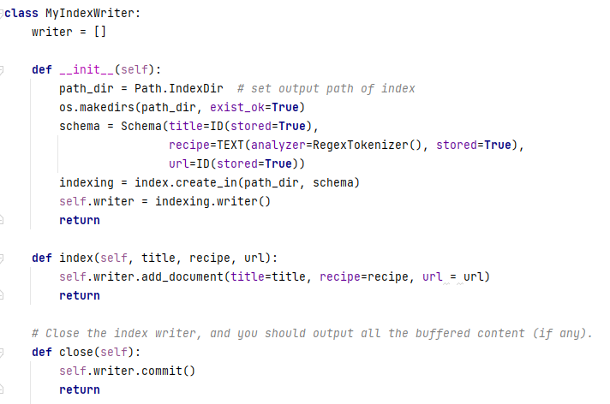
Details of Approach – Writing the Index with Whoosh Library Python

Slide 9
Details of Approach – Reading the Index with Whoosh Library Python
MyIndexReader – uses whoosh searcher object in functions to return following…
recipeID (recipe title)
url
token’s document frequency
token’s collection frequency
recipe document’s length.
It also contains the function that creates the postings list from the index using Whoosh searcher object to search index

Slide 10
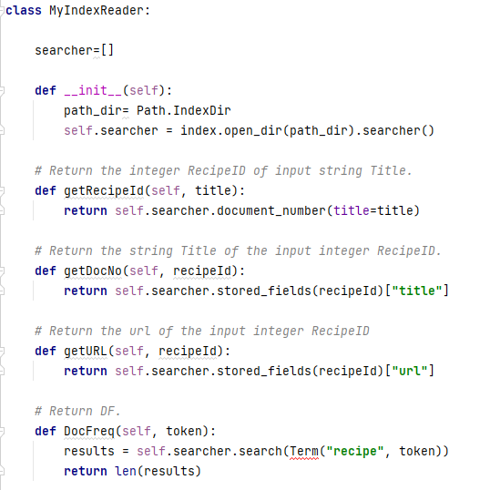
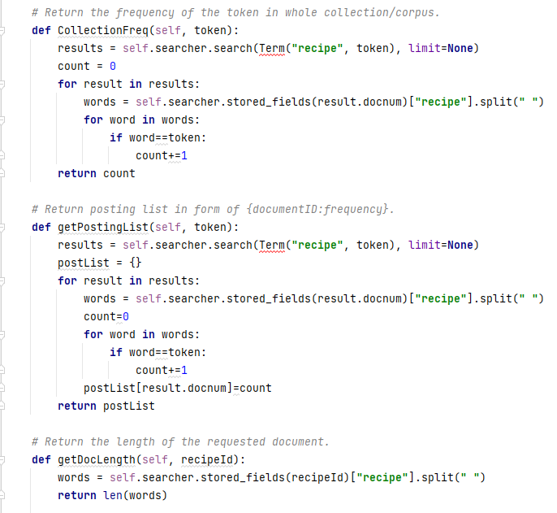
Details of Approach – Reading the Index with Whoosh Library Python

Slide 11
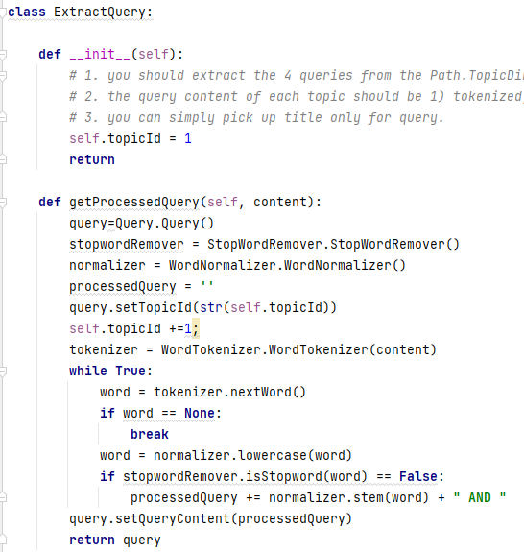
Details of Approach – Query Extraction
ExtractQuery
Takes user query as input
returns the processed query
getProcessedQuery
Uses the same preprocssing approach as performed on the recipe dataset input
Includes tokenization, stop word removal, and normalization of the query input

Slide 12
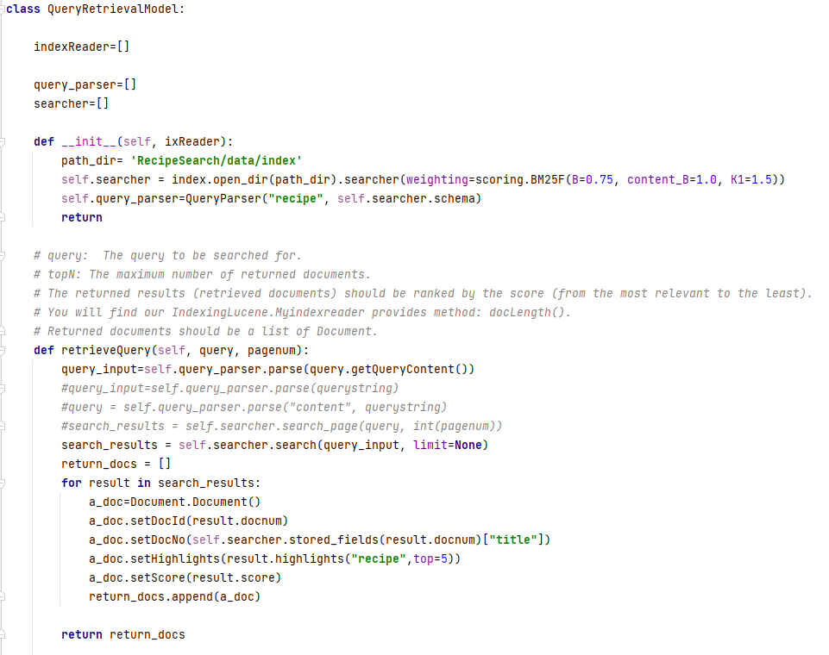
Details of Approach – Query Retrieval and Scoring with Whoosh Library Python
QueryRetrievalModel
Takes user query as input
Returns the set number of recipe documents determined by the scoring
Whoosh QueryParser to convert query string into query object
Whoosh searcher object used for searching and scoring results from index
Whoosh BM25F algorithm used for scoring the returned recipe documents.
Default values of B=0.75 and K1 = 1.5 used

Slide 13
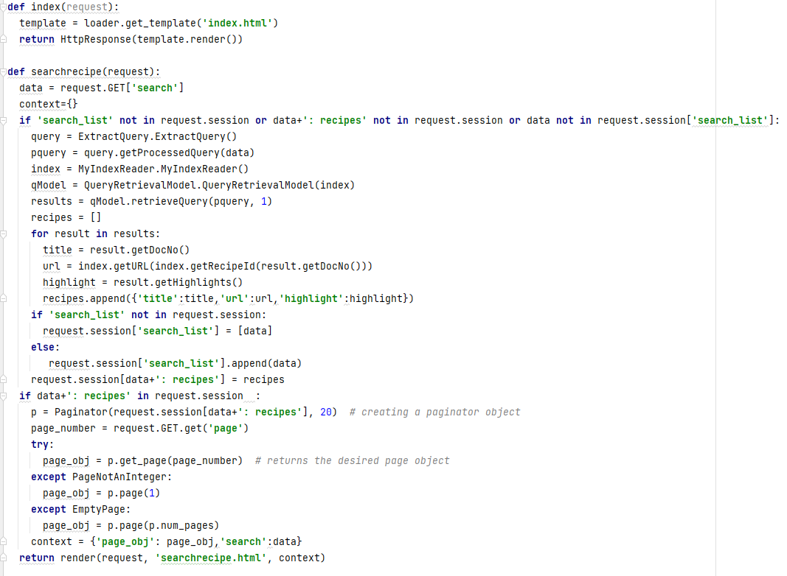
Details of Approach – Creating web page and integrating backend using Django
Frontend html web page created using Django library
Views.py Django file includes:
Web page creation and display of results
Query extraction and retrieval
Reading of the Index
Figure 3: views.py

Slide 14
Details of Approach – Overview
MyIndexReader –built index as input
getURL
QueryRetrievalModel – built index and user query as input
retrieveQuery
Django views.py
ExtractQuery – user query as input
getProcessedQuery
WordNormalizer – converts all cases to lowercase in word array, performs stemming, and returns each word
WordTokenizer – removes punctuation and returns a word array
StopWordRemover – returns Boolean True/False if word is a stop word

Slide 15
Performance Evaluation
The system performs well in the following ways:
Final project output is a user-friendly search engine that allows user to search for a specific ingredient or recipe title
System returns recipes results with Title and description along with clickable url that leads to the recipe instructions
System highlights the searched query in the returned results results
Improvements
The title of the recipe was preprocessed and indexed along with the rest of the content , there is no separate search capability for the title only.
Ex: a query for the title “funny funny chicken” returns the recipe titled as “funny funny chicken” as the second highest result
There is no filtering capability for the results returned

